Slide 1

Breast Cancer Prediction
Breast cancer is a group of diseases in which cells in breast tissue change and divide uncontrolled, typically resulting in a lump or mass. Most breast cancers begin in the lobules (milk glands) or in the ducts that connect the lobules to the nipple.

Slide 2
1. Introduction
Breast Cancer is the Most common cancer in women in India, in cities and in rural areas of India as well.
Am I worried about the trends of breast cancer in India? Yes, very much. But can we change the trend? No, of course not. But what we can change is our 'ignorance', our 'lack of awareness'. You will understand what I mean, from the discussions in this section. Breast cancer is a global disease. Though most underlying causes, and other features are usually uniform around the world, every region has its own uniqueness for that cancer. Let us assess the trend of breast cancer in India.

Slide 3
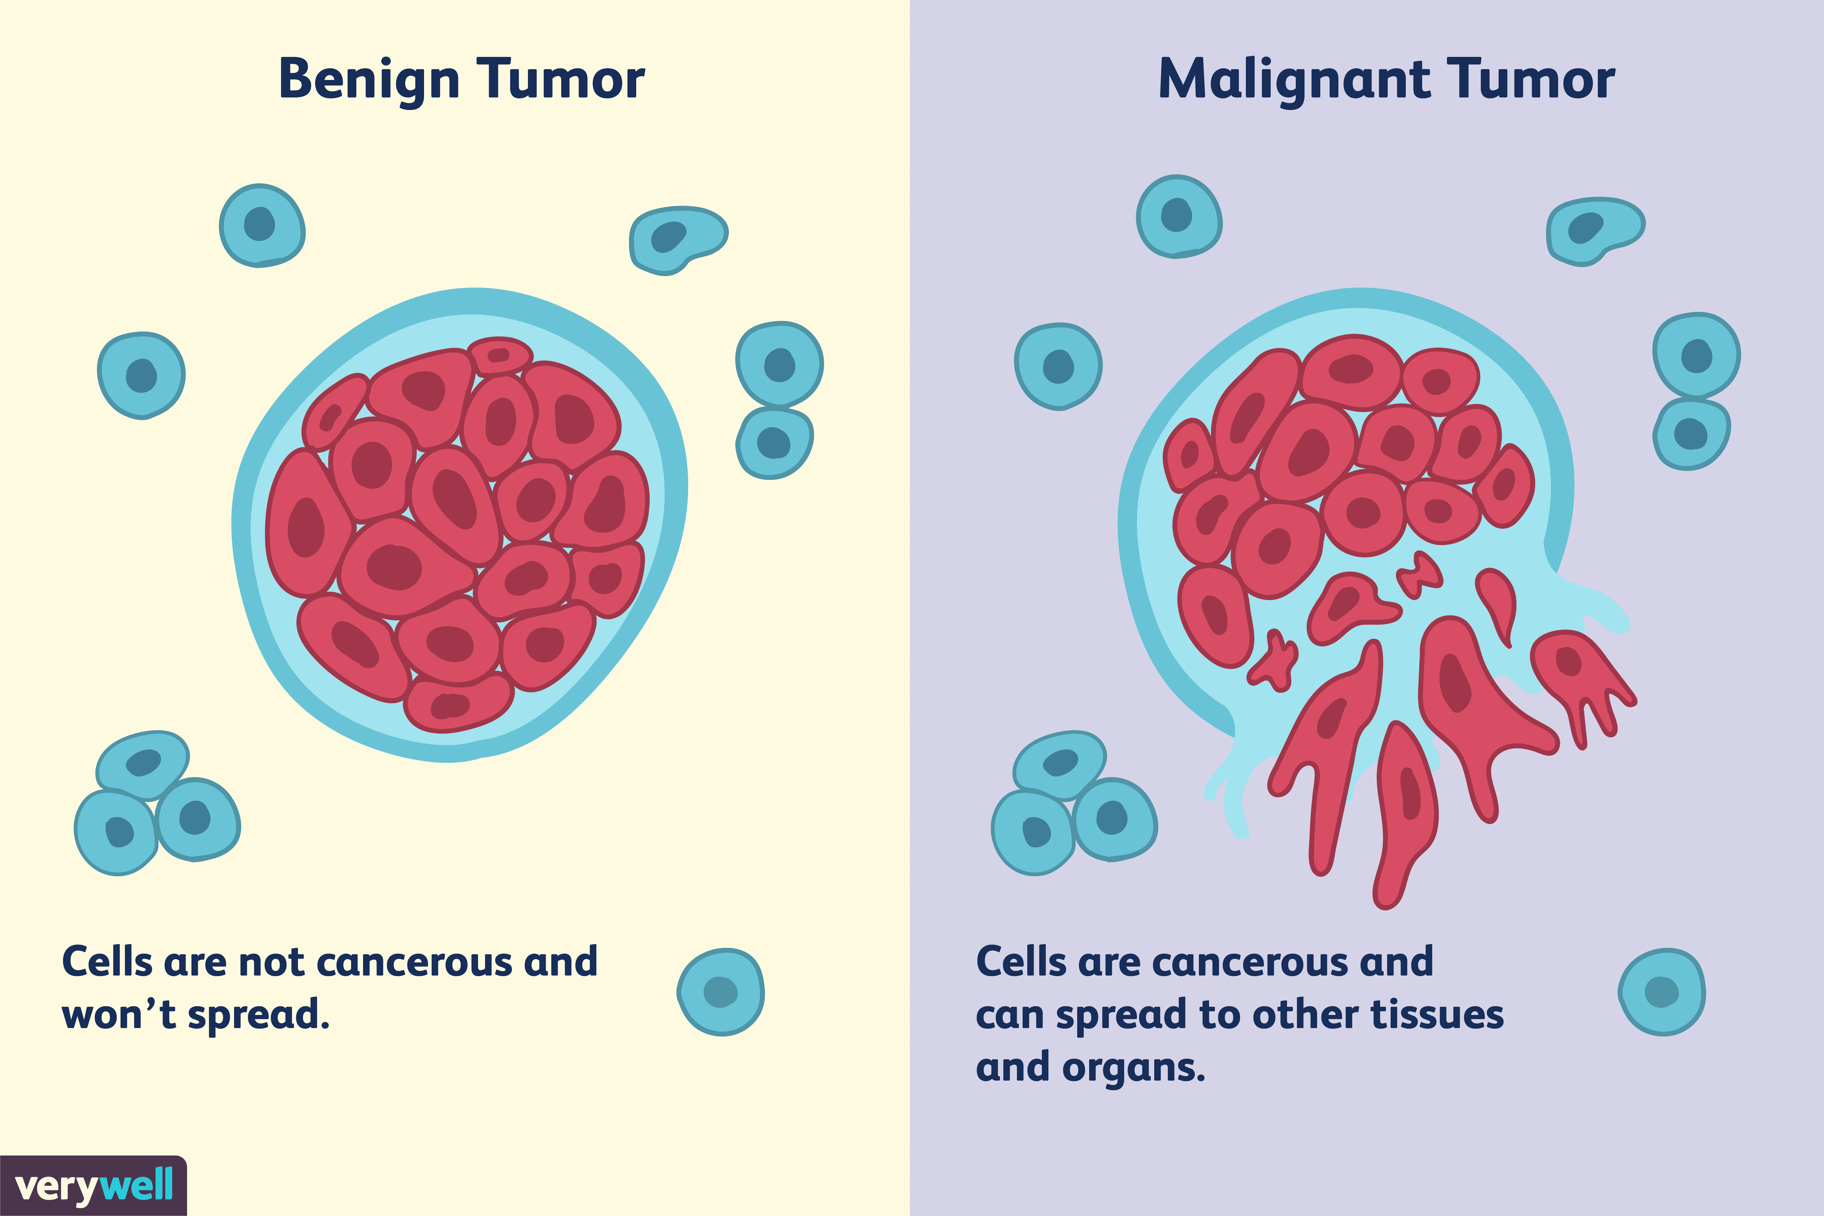
The key challenge in cancer detection is how to classify tumours into malignant or benign. Machine learning techniques can dramatically improve the accuracy of diagnosis. Research indicates that most experienced physicians can diagnose cancer with 79 percent accuracy while 91 percent correct diagnosis is achieved using machine learning techniques. In this case study our task is to classify tumours into malignant or benign tumours using features obtained from several cell images. Let us look at the cancer diagnosis and classification process. So, the first step in the cancer diagnosis process is to do what we call it fine needle aspirate or FNA process which is simply extracting some of the cells out of the tumour. And at that stage we do not know if that tumour is malignant or benign. When we say malignant or benign as you guys can see these are kind of the images of the cell. This would be benign tumour and on the right side is the malignant tumour.

Slide 4
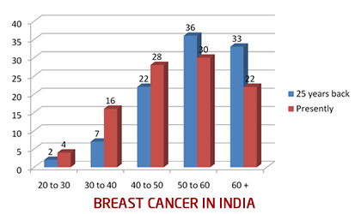
Increasing Incidence of BC in Younger Age Groups (30s and 40s)
In India, we are now witnessing more and more numbers of patients being diagnosed with breast cancer to be in the younger age groups (in their thirties and forties). Please consider the adjoining graph (This is only a rough representation of the data, for your understanding, the data used for this representation are rough estimates):
The horizontal line lower down represents the age groups: 20 to 30 years, 30 to 40 yrs. and so on. And the vertical line represents the percentage of cases. The blue color represents the incidence 25 years back, and maroon color represents the situation today. 25 years back, out of every 100 breast cancer patients, 2% were in 20 to 30 years age group, 7% were in 30 to 40 and so on. 69% of the patients were above 50 years of age. Presently, 4% are in 20 to 30 yrs. age group, 16% are in 30 to 40, 28% are in 40 to 50 age group. So, almost 48% patients are below 50. An increasing numbers of patients are in the 25 to 40 years of age, and this is a very disturbing trend.
Of course, one reason for higher numbers of younger patients is our population pyramid, which is broad at the base and middle and narrow at top, which means that we have a huge population in the younger age group and much lesser in older age group.

Slide 5
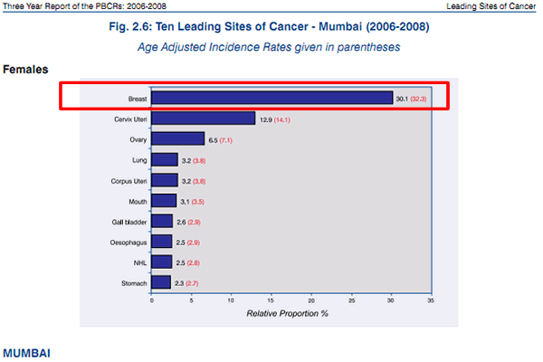
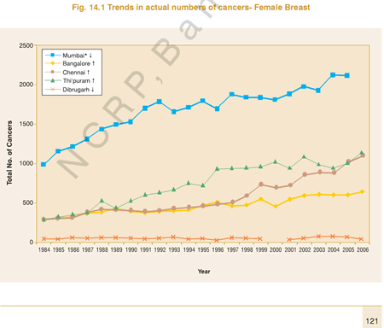
Increasing Incidence of Breast Cancer in India
Initially, before the 2008 statistics, cancer of the Cervix was the most common cancer in women in India and Breast cancer was second most common.
When the 2008 statistics came out, Breast Cancer overtook Cervical cancer as the most common cancer in Indian cities. But Cervical cancer was still common in rural areas.
And with the 2012 statistics report, Breast Cancer in India made a huge jump - The numbers rose so rapidly, that the difference on numbers between breast and cervical cancer was quite stark. In most Indian cities, Breast Cancer amounted to almost 25 to 32 percent of all cancers in women, whereas Cervical cancer was around 8 to 9 percent.
And the numbers are just going on rising. You can read a detailed analysis and discussion of breast cancer in India in the section
The Upper Image shows a bar graph about percentage distribution of top ten cancers in females in Mumbai, for the year 2006 - 2008. You can clearly note how common was breast cancer then, was back in 2008. And today, as of May 2020, this number has only risen much more.
The Lower Image shows trend of breast cancer in a few cities like Mumbai, Bengaluru, Chennai, Thiruvananthapuram and Dibrugarh. Of course, this graph is old, up to 2006 only but still it shows the rising trend in all cities.

Slide 6
2. Visualization of our Features

Slide 7
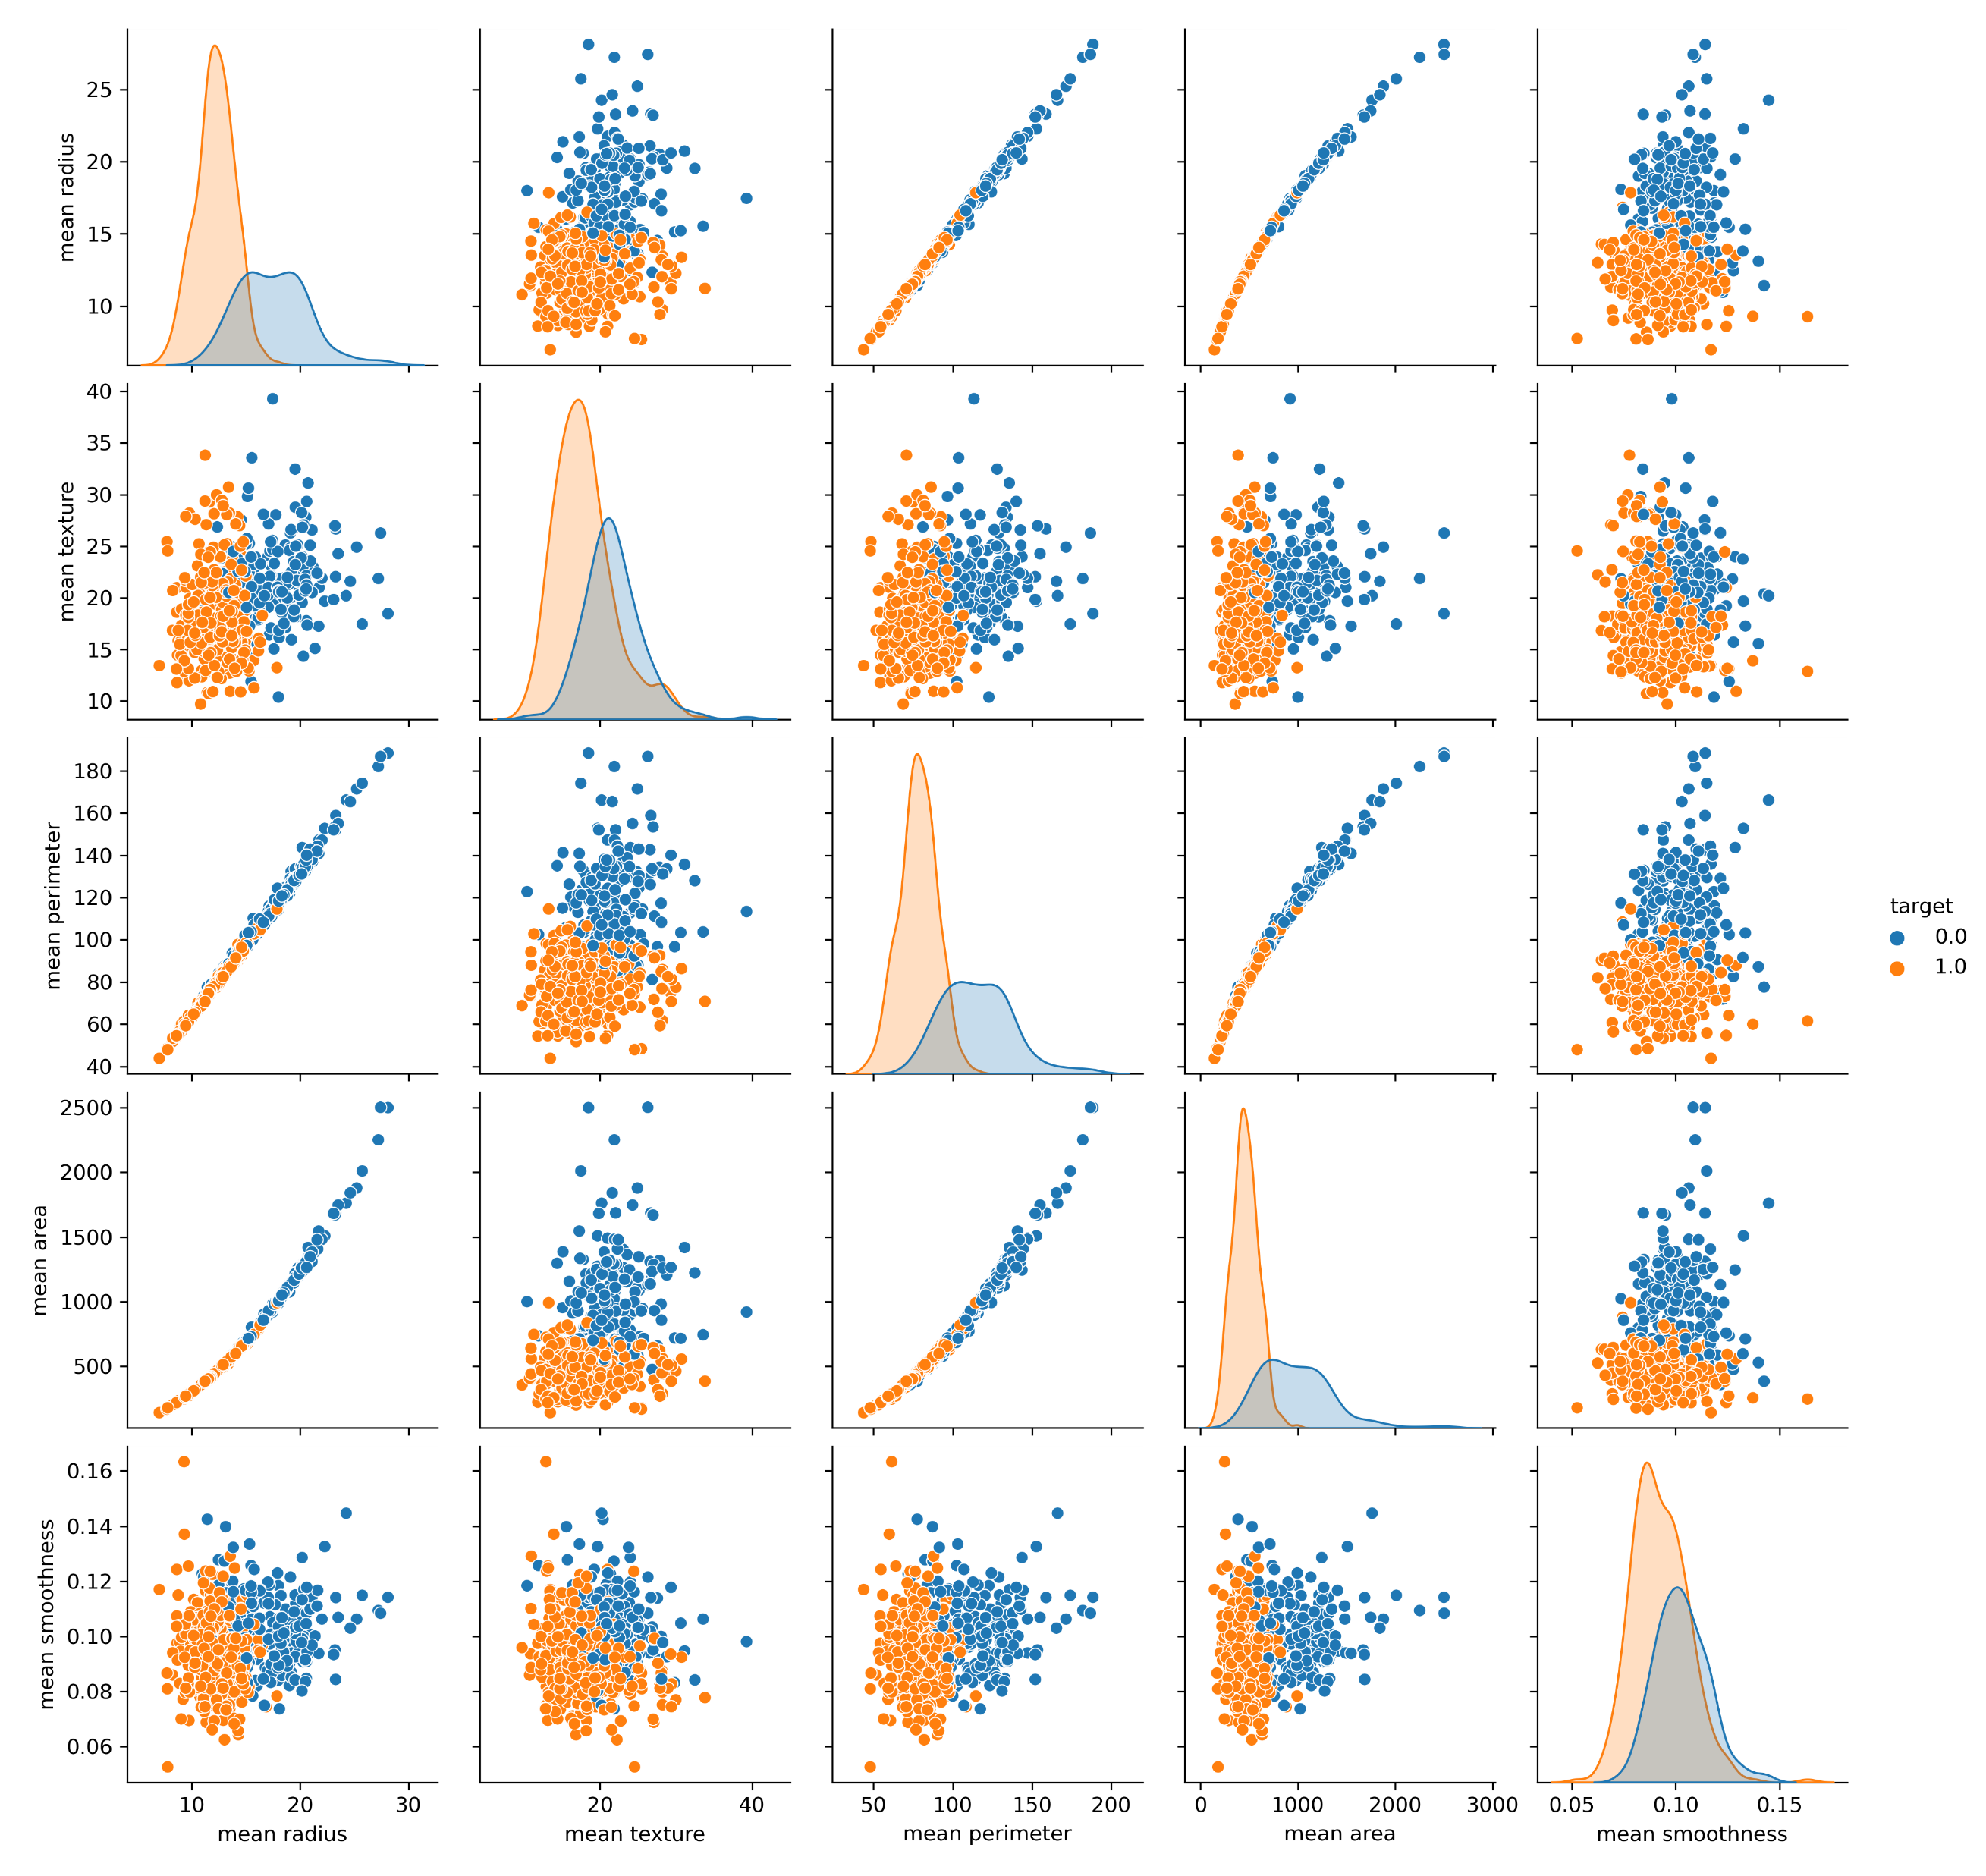
The adjacent figure represents the first 5 features from our data and how they relate to each other.
Note that ‘0’ is for Benign tumour while’1’ is for malignant tumour.
One of the many observations to see is that mean radius and mean perimeter have a linear relationship.
Whenever the mean area increases wrt mean radius, the chances of a benign cell increases. This means that the patient can be safe.
When the mean smoothness is at the middle, the mean area decides if the cell is benign or malignant. The higher the area, more are the chances of a benign tumour.
This goes on for each and every comparison. Note that we have only compared the first 5 features with each other. We have in total of 30 features.

Slide 8
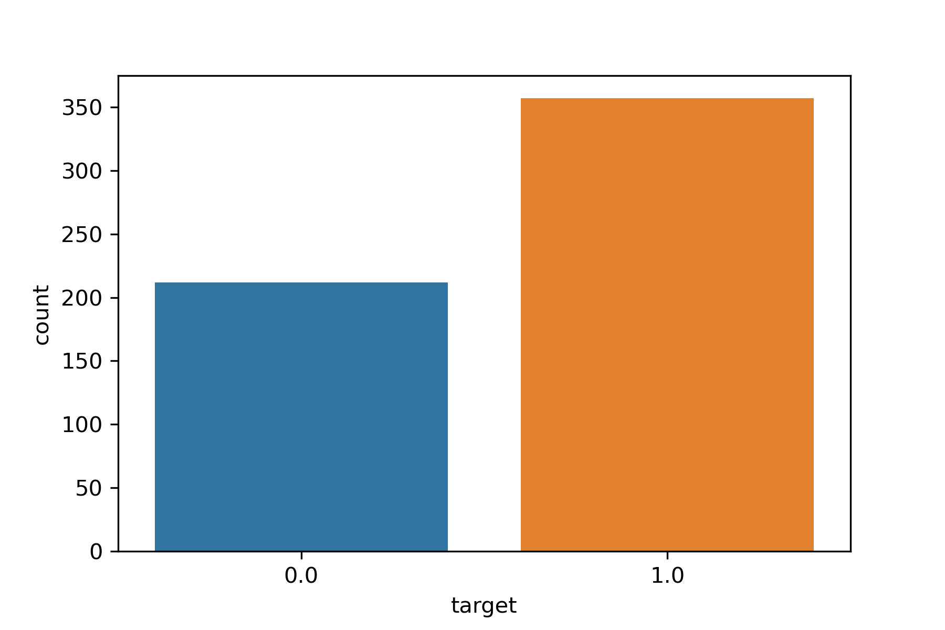
This is a Count Plot of our data.
It simply shows us the count of each of out target(y) values. Either 0 or 1.
0 represents Benign and 1 represents malignant tumour.
There are approx. 350k patients with a malignant tumour.
That of Benign tumour was slightly more than 200k.
Patients with a malignant tumour are positive to breast cancer and shall be treated urgently.

Slide 9
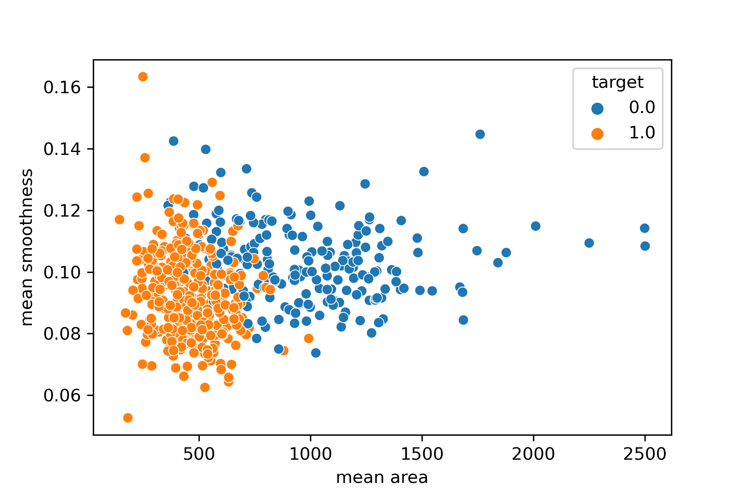
A Scatter Plot representing mean area and mean smoothness.
The lower the mean area and mean smoothness, the higher the chances of a malignant tumour.
But the main problem here is that our data is not scaled so we cannot know the exact differences. Still our conclusion is correct.

Slide 10
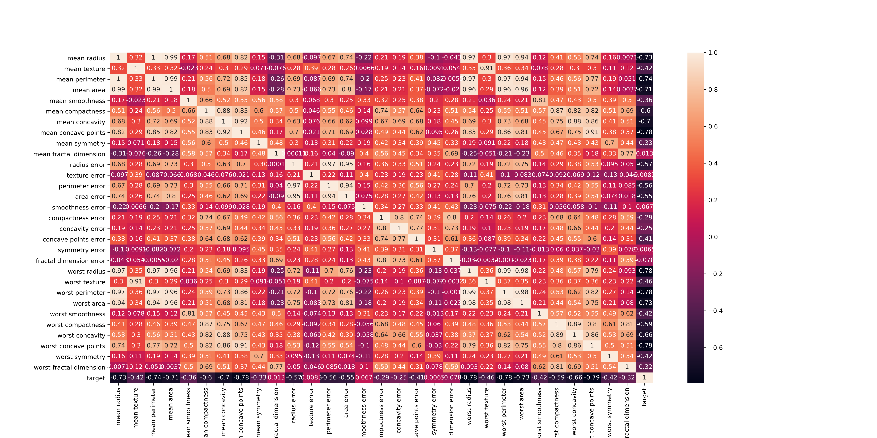
The adjacent figure is a heatmap of our whole dataset including our y variable(feature).
Mean radius, mean perimeter and mean area are one of the most highly correlated points to our worst perimeter feature.
These types of correlations can also be seen with our target variable which is seen in the heatmap.

Slide 11
3. Model Evaluation

Slide 12
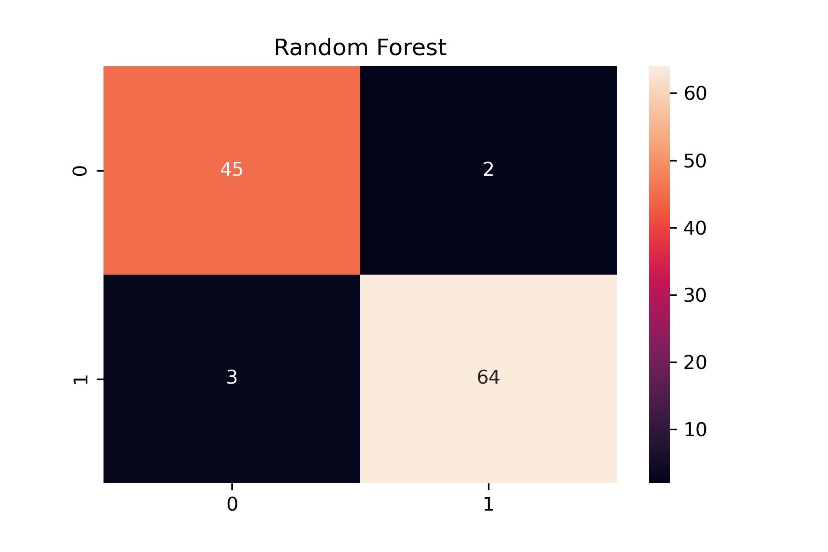
3.1 Random Forest
After visualizing and building our model, we must evaluate it in order to know if our model solves our problem. Here I will only show confusion matrix, but you can have a look at different accuracy metrics of all the models in my main notebook.
The adjacent figure is a confusion matrix of our random forest algorithm.
It shows that we had 2 “type 1 error” while 3 “type 2 error”.
Type 2 errors are the worst as they predict that the patient does not have a malignant tumor when in real, they had.
We will try another model to see if we can reduce the number of type 2 error.

Slide 13
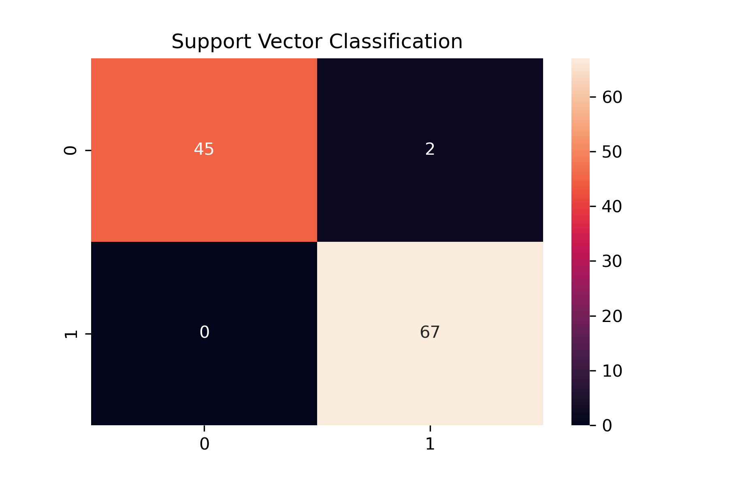
Support Vector Classification
This model has 0 “type 2 error” and so can be used further.
Although we should tune the parameter to achieve even more accuracy.
As for the accuracy, we have 45 True Positives and 67 False Positives.
A classification report of this can be found in my main notebook.

Slide 14
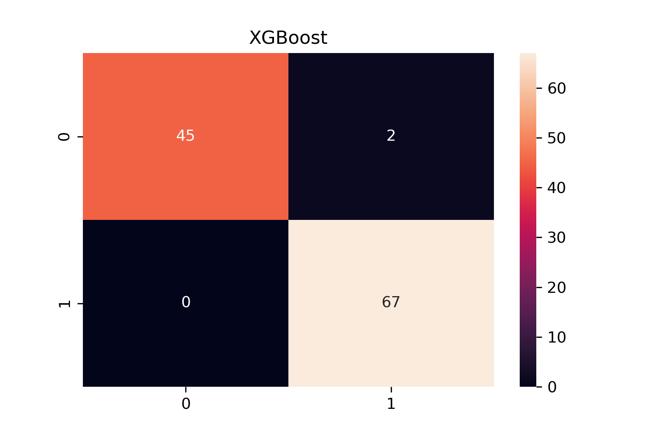
XGBoost
This is a confusion matrix of an XGBoost model.
The result of this model is identical to that of a Support Vector Machine.
Due to this we can use any of the algorithm for our problem.
Although Parameter tuning should reveal more fantastic results.

Slide 15
4. Conclusion
It is important to understand that breast cancer can occur in the younger population as well. We saw that 37.7% of all newly detected breast cancer cases were in the 25 to 49 years age group. For most, breast cancer is an illness of the elderly, but it is not so. Also, many young breast cancers tend to be very aggressive and have to be tackled in proper sequence of surgery and other treatments, and needless to say, early detection will definitely give high cure rates.
If you have read all the above points, they are all pointing to one necessity - 'Detect Breast Cancer Early'. Since the number of cases are rising, more younger women are getting affected, most are presenting only after symptoms develop (so usually stage 2B and beyond, rarely earlier stage) and we cannot prevent this cancer, all we can do is to detect this cancer early.

Slide 16
5. Resources
https://breastcancerindia.net/
https://breastcancerindia.net/statistics/trends.html
https://breastcancerindia.net/statistics/latest_statistics_breast_cancer india.html -
https://www.cancer.org/content/dam/cancer-org/research/cancer-facts-and-statistics/breast-cancer-facts-and-figures/breast-cancer-facts-and-figures-2019-2020.pdf

